Slide 1
DOM

Slide 2
DOM Methods accessing attributes and styles
getElementById - To change/modify the content of an HTML element
<script>
document.getElementById("p1").innerHTML = "New text!";
</script>
Changing HTML Content
<script>
document.getElementById("myImage").src = "landscape.jpg";
</script>
Changing the Value of an Attribute
<script>
document.getElementById("myP").style.backgroundColor = "red";
</script>
Changing Style property
<script>
document.getElementById("myP").classList.add(“box”); </script>

Slide 3
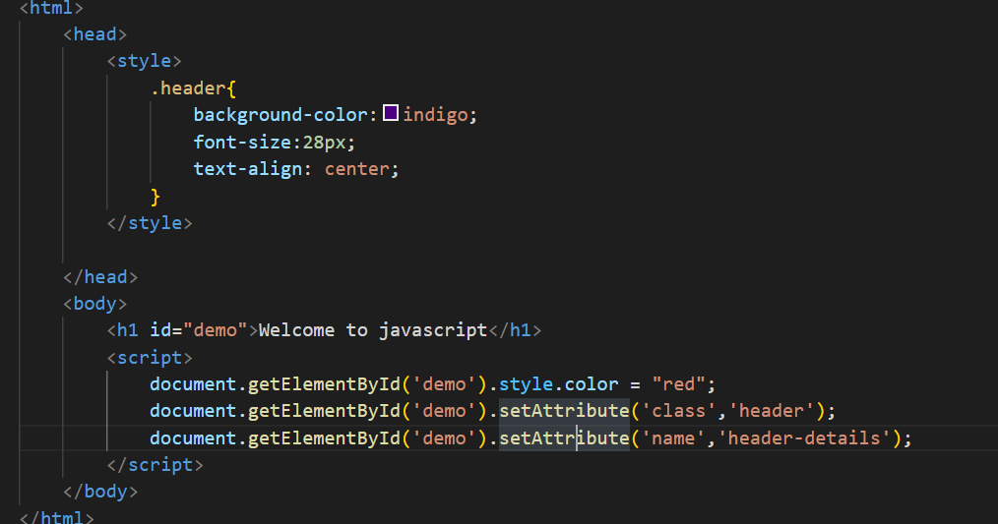
Style and class

Slide 4
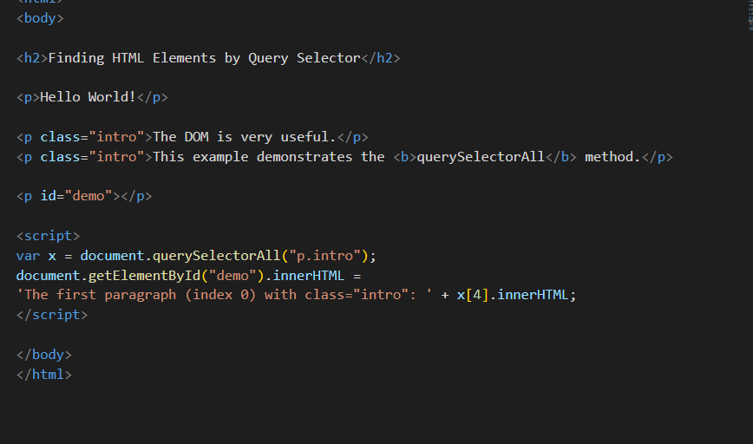
CSS QuerySelector

Slide 5
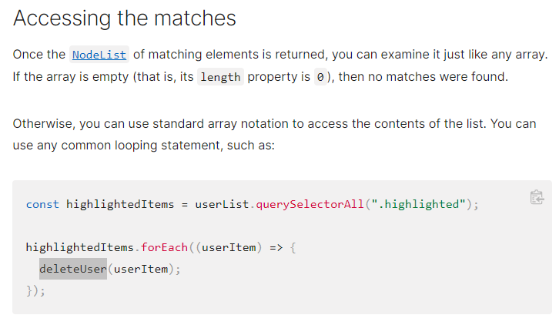
CSS QuerySelector

Slide 6
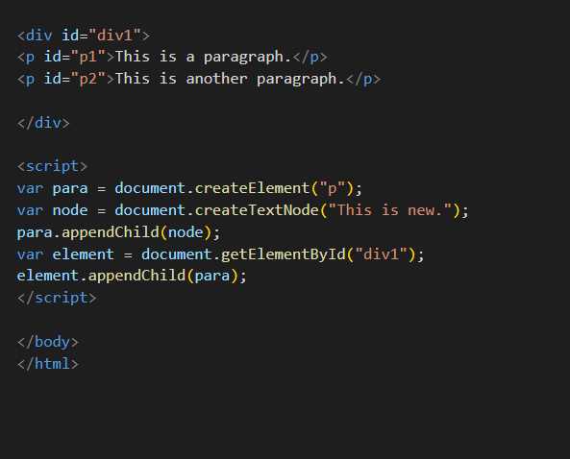
ADD DOM

Slide 7
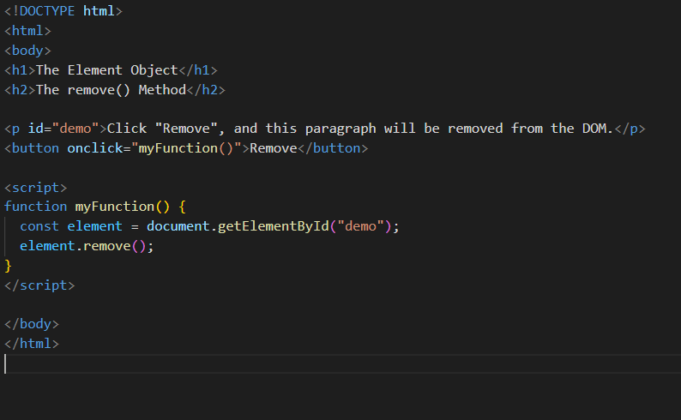
Remove DOM

